Slide 1

Pune Institute of Computer Technology, Pune Dept. of E&TC
304200: Mini Project (MP) (2019 Course)
“Self Balancing Beam”
Guided By: Prof. V.B. Vaijapurkar
By:
1) Shreyas Deshpande(32122)
2) Siddharth Gajarmal(32125)

Slide 2
Introduction
Control theory is a sub-field of mathematics operating within the area of dynamic systems. The main purpose of developing a control model is to either stabilize an unstable system or modulating the desired response and outcome of a given system. Hence, the aspiration of this project is to demonstrate how theory is actualized in a physical model and how alterations and defects in implementation causes differences in physical response.

Slide 3
Aim
Develop a self balancing system using PID Controller
Objectives
Learn about balancing systems
Design and develop PID controller for controlling the system
Verify the performance and observe the results and errors

Slide 4
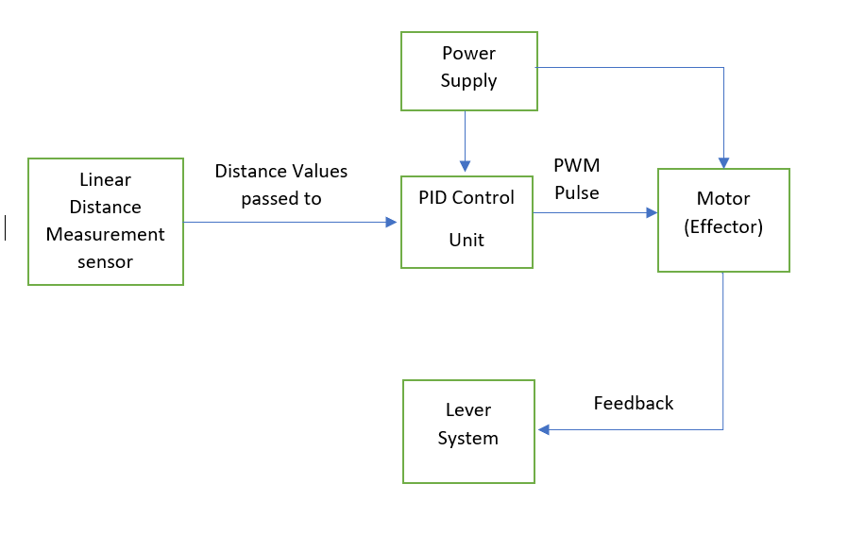
Block Schematic

Slide 5
resources Required
Hardware Requirements:
Microcontroller
Motor
Linear Distance Measurement Sensor
Lever system
Software Requirements:
Arduino IDE
Fusion 360
Proteus 8

Slide 6
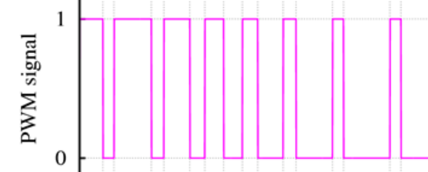
Working model Animation
Distance Measurement sensor
Feedback loop continues
Motor

Slide 7
Features, future Scope
This PID controller can be used for various applications like:
Robot balancing/stabilizing
Automatic/Dynamic control
Precise stepper motor actuation control
Speed Control of Motors
Maintaining temperatures for oven/baking

Slide 8
References
Blogs
https://www.electronicshub.org/pid-controller-working-and-tuning-methods/
Research papers:
https://www.diva-portal.org/smash/get/diva2:1373784/FULLTEXT01.pdf
https://docplayer.net/35942611-Balancing-a-ball-and-beam-with-pid.html
Datasheets and manuals:
https://docs.arduino.cc/resources/datasheets/A000066-datasheet.pdf
https://global.sharp/products/device/lineup/data/pdf/datasheet/gp2y0a21yk_e.pdf
https://components101.com/sites/default/files/component_datasheet/HCSR04%20Datasheet.pdf
https://datasheetspdf.com/pdf-file/791970/TowerPro/SG90/1
https://www.es.co.th/schemetic/pdf/et-servo-s3003.pdf
Books:
PID Controllers: Theory, Design and Tuning - by Karl J. Astrom (Author), T. Hagglund (Author)

Slide 9
Thank You!

